Slide 1

Artificial Neural Network: Gradient Descent
Mina Farmanbar
Associate Professor, University of Stavanger
for engineers

Slide 2
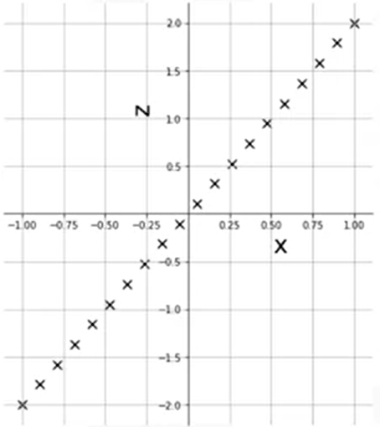

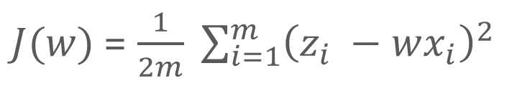

Cost Function
$$Z=2X$$
$$Z=wX$$
$J(w)$= $\frac{1}{2m} \sum_{i=1}^{m}{{\left(z_{i} −wx_{i}\right)}^{2}}$
predicted values
cost or loss function

Slide 3
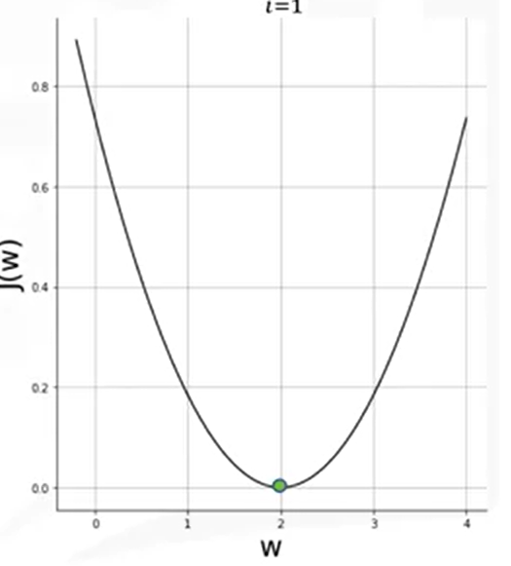


Cost Function
$$Z=wX$$
$J(w)$= $\frac{1}{2m} \sum_{i=1}^{m}{{\left(z_{i} −wx_{i}\right)}^{2}}$

Slide 4
Cost Function
We use optimization algorithms like gradient descent
to find the weights that minimize the cost function in these more complex scenarios.

Slide 5



Gradient Descent
Gradient descent is an iterative optimization algorithm for finding the minimum of a function.
Gradient is the slope of a curve at a given point.
The gradient is given by the slope of the tangent at w = 0.2, and then the magnitude of the step is controlled by a parameter called the learning rate.
learning rate
$$w^{0}$$
$$α{∂J}/{∂w}$$
$$w^{1}$$

Slide 6
Gradient (A slope of a curve at a given point )
We need to Update the value of parameter (𝑤) by adding up the existing value of parameter and the descent value

Slide 7
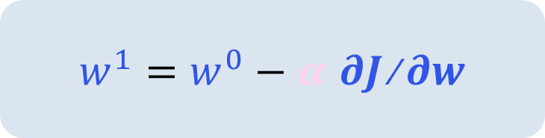



Gradient Descent
$w^{1}=w^{0}−$ 𝜶 𝝏$J$⁄𝝏𝒘
We keep repeating this step until we hit
the minimum or a value of the cost
function that is very close to the
minimum, within a very small predefined
threshold.
$$w^{0}$$
$$α{∂J}/{∂w}$$
$$w^{1}$$

Slide 8
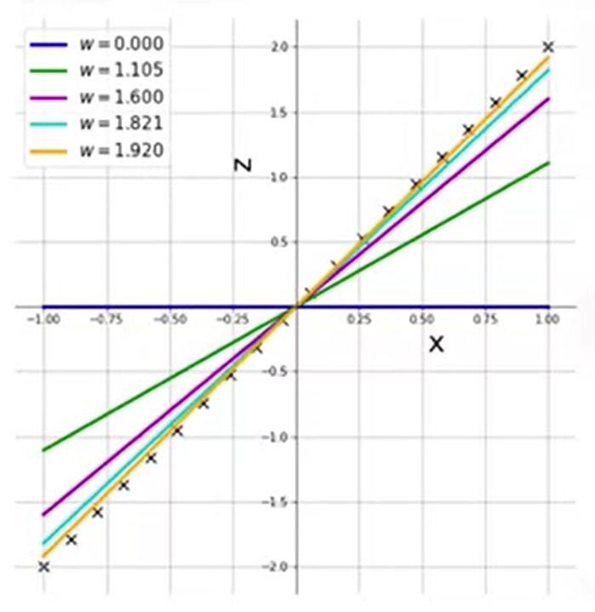


Gradient Descent
Step 1: Pick a random point.
Step 2: Calculate the value of the derivative at this point.
Step 3: Use the relationship $w^{1}=w^{0}−$ 𝜶 𝝏$J$⁄𝝏𝒘 to calculate the new value.
Go back to step 2
$$Z=wX$$

Slide 9
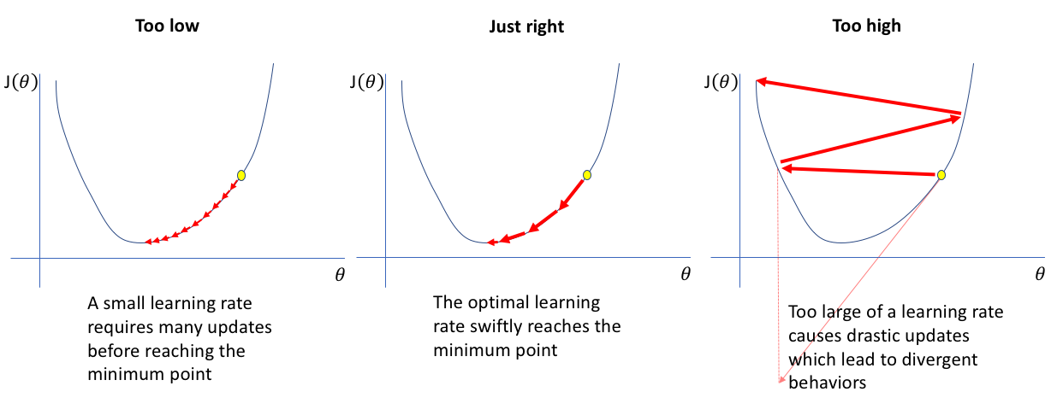
Learning Rate, α
https://miro.medium.com/v2/resize:fit:640/format:webp/1*zeZBVUfOju8dM1BoK56dpg.png

Slide 10





Learning Rate, α
$$\text{α}\text{=0.1}$$
$$\text{α}\text{=0.}\text{2}$$
$$\text{α}\text{=0.}\text{4}$$
$$\text{α}\text{=0.}\text{6}$$
$$\text{α}\text{=0.}\text{8}$$

Slide 11
Thank you!
Mina Farmanbar
mina.farmanbar@uis.no

